Slide 1
The Serengeti
Global History and Geography I
Mr. Cox

Slide 2
Bellringer
Define the climate region: savannah
Essential Question
What factors make the climate and landscape of Africa so diverse?

Slide 3
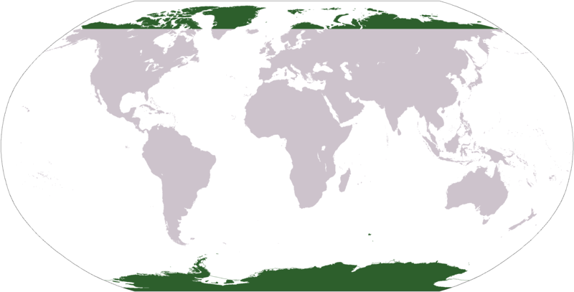
E. Polar Climate
8-10 months of snow
Generally underlain by permafrost
Days are long and temperatures may reach the teens in summer
Vegetation:
Stunted sedges, mosses flowering plants and lichen in brief summer
Most rapid climate warming is in this zone
Only in northern hemisphere, except in highlands

Slide 4
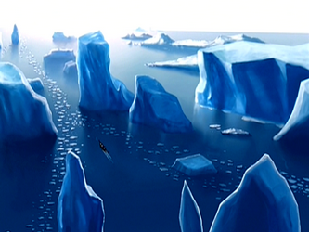
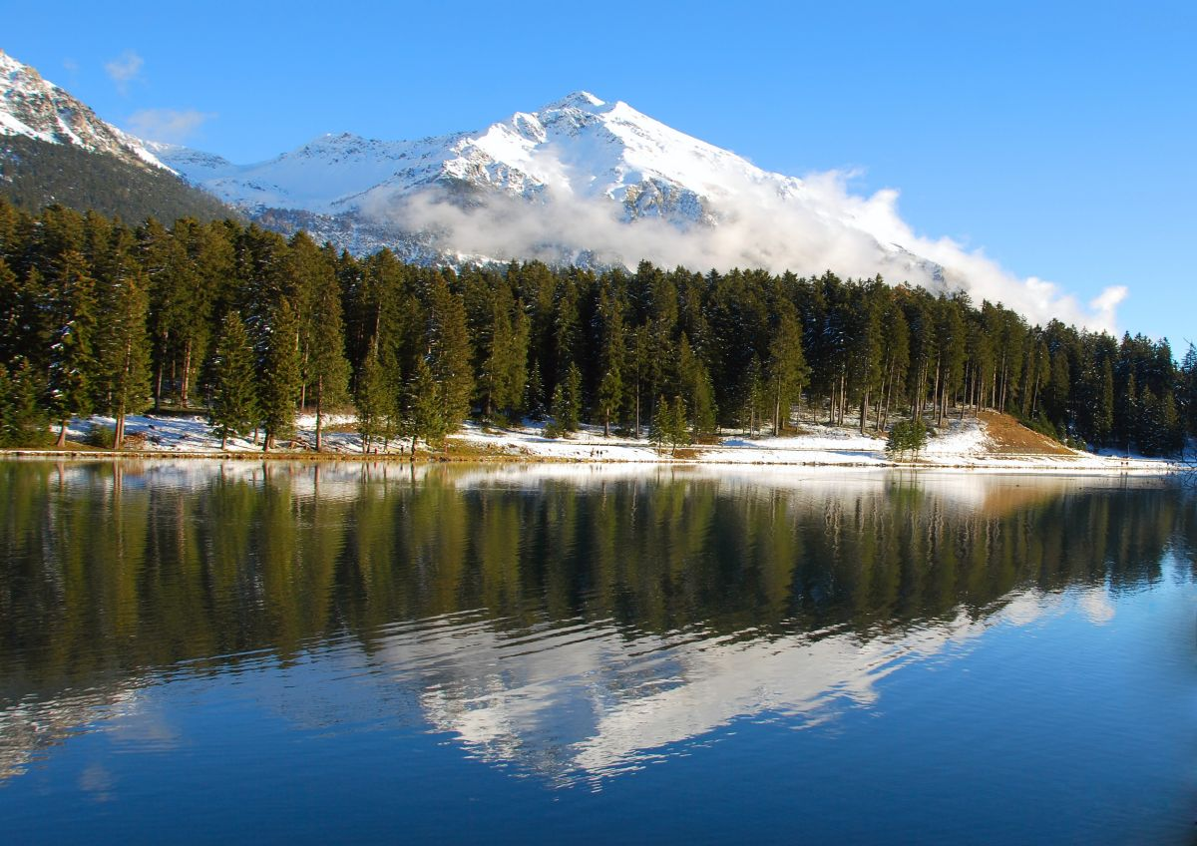
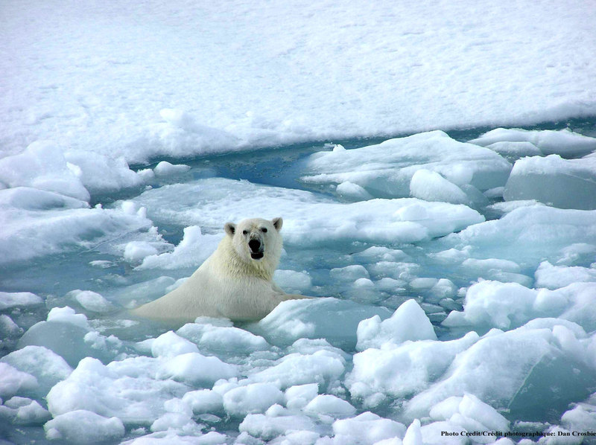
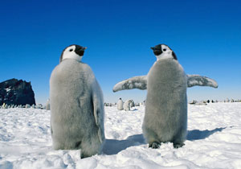

Slide 5
The Serengeti Region
The Serengeti ecosystem is a geographical region located in north-western Tanzania and extends to south-western Kenya .
The Serengeti hosts the largest and longest migration in the world, which is one of the ten natural travel wonders of the world .
The region contains several national parks and game reserves. Serengeti came from the Maasai language, and it means" Endless Plains"
Around 70 larger mammals and some 500 fauna species are found there.

Slide 6
Serengeti National Park
One of the most celebrated wildlife reserves in the world. Created to protect the path of the world’s largest movement path, covers nearly 15,000 square kilometers.
Famous for its huge concentrations of wildlife, especially the big cats, and migration patterns

Slide 8
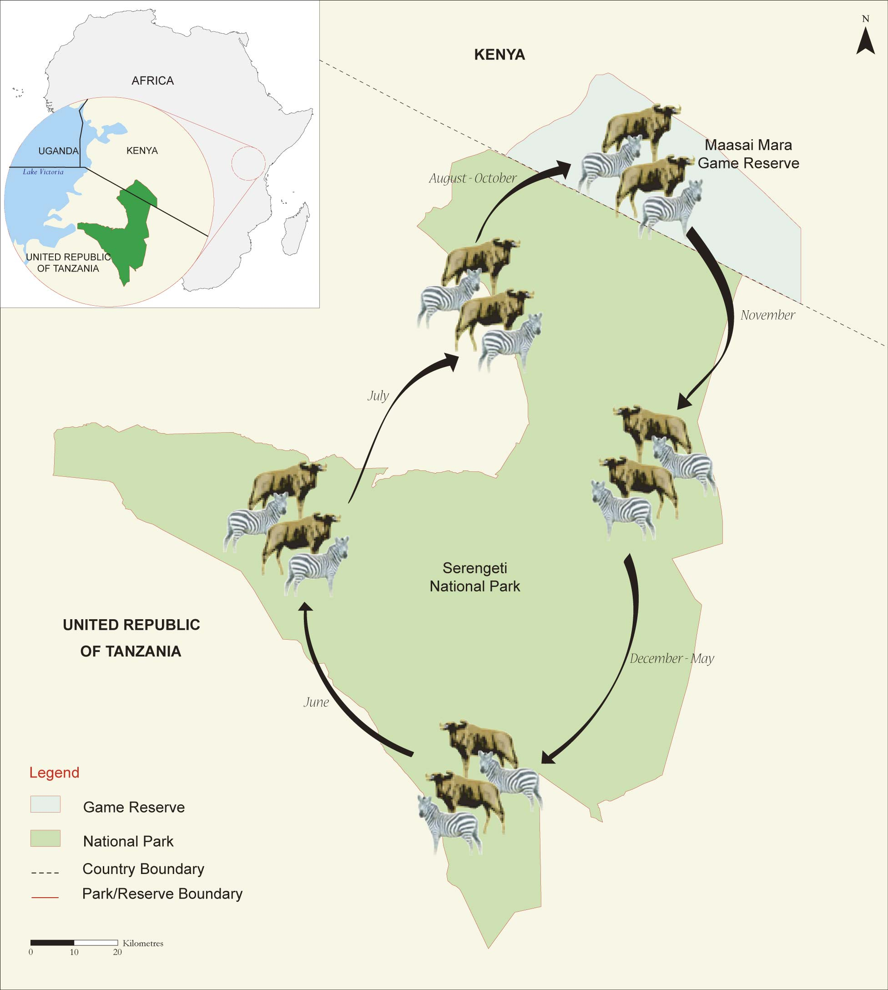

Slide 9
Big 5 Animals in the Serengeti
Lions: male lions are much larger than lion females. A male lion may control a pride and live of it’s hunting successes.
Elephants: the African elephant is the largest land animal. They weigh as much as four cars.
Leopards: leopards are solitary big cats that live all over Africa, while they are not generally a threat humans , they will eat about everything .
Rhinos: There are five species of rhinoceros in the world , two of them are found in Africa.

Slide 10
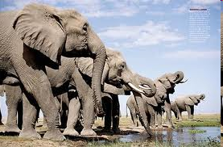
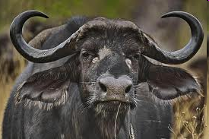
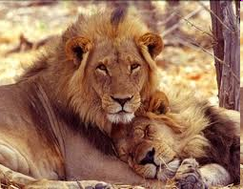
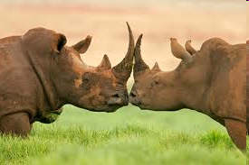
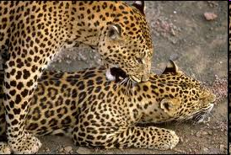
Cape Buffalo: the buffalo has been one of Africa’s most successful large mammals the cape buffalo lives throughout sub-Saharan Africa.

Slide 11
Serengeti Video
As the video plays, take notes on interesting facts presented in the film. You will be required to write a brief summary of the video as an in-class assignment.
Topics to take notes on
Types of animals
Animal migrations (why and where)
Human life in the Serengeti
The Serengeti today
http://www.youtube.com/watch?v=mvgv_hCts40

