Slide 1
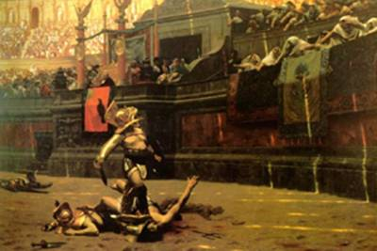
The Golden Age of Rome
Global History and Geography I
Mr. Cox

Slide 2
Bellringer
What is your favorite form of entertainment today?
Essential Question
What were the characteristics of the “Pax Romana”?

Slide 3
II. Pax Romana
Pax Romana
200 year period of peace, prosperity, and cultural achievement (after Augustus)
Bread and Circuses: Entertainments for Romans
Provided to please Romans and overlook problems
Officials would feed citizens at public events
Colloseum, Circus Maximus
Empire grew wealthy due to trade along the massive road system

Slide 4
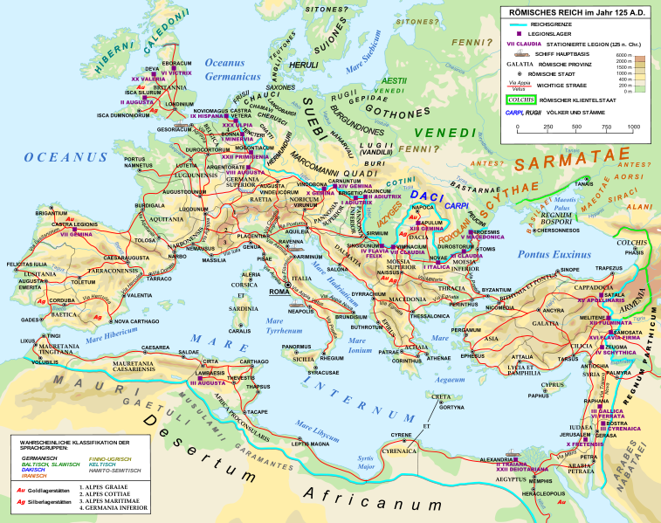

Slide 5
Quickwrite
Why did Roman Emperors institute the policy of Bread and Circuses?
Watch the crowds in the video clips. What are their reactions to the events in the Colloseum?
http://www.youtube.com/watch?v=s66zFW3nogU

Slide 6
II. Literary Achievements
Famous writers and playwrights emerged during this time
Virgil: Aenid
Ovid: poet, wrote Art of Love
Cicero: lawyer/historian/philosopher
These writings provided great insight into the Roman world

Slide 7
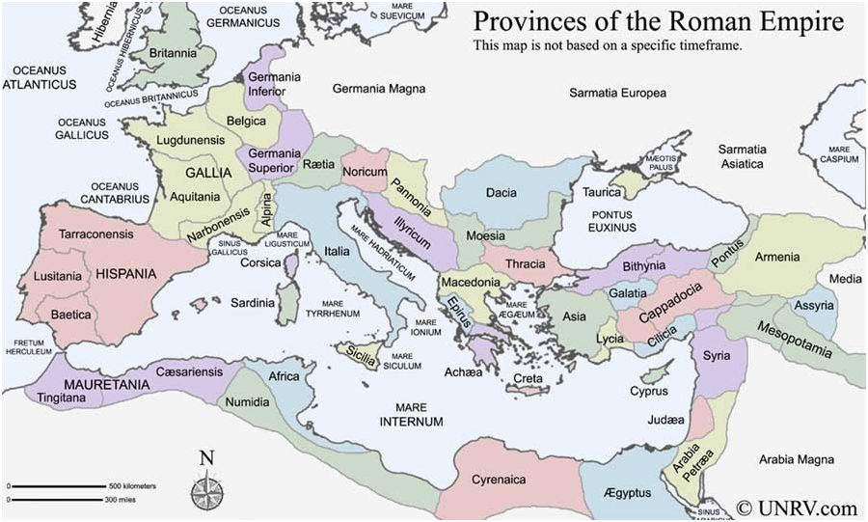
III. Issues Arise in Rome
Patrician Corruption
Wealth disparity
Most of the wealth in society is in the hands of the few, not the many
Cruel governing policies of new provinces
Take the people as slaves

Slide 8
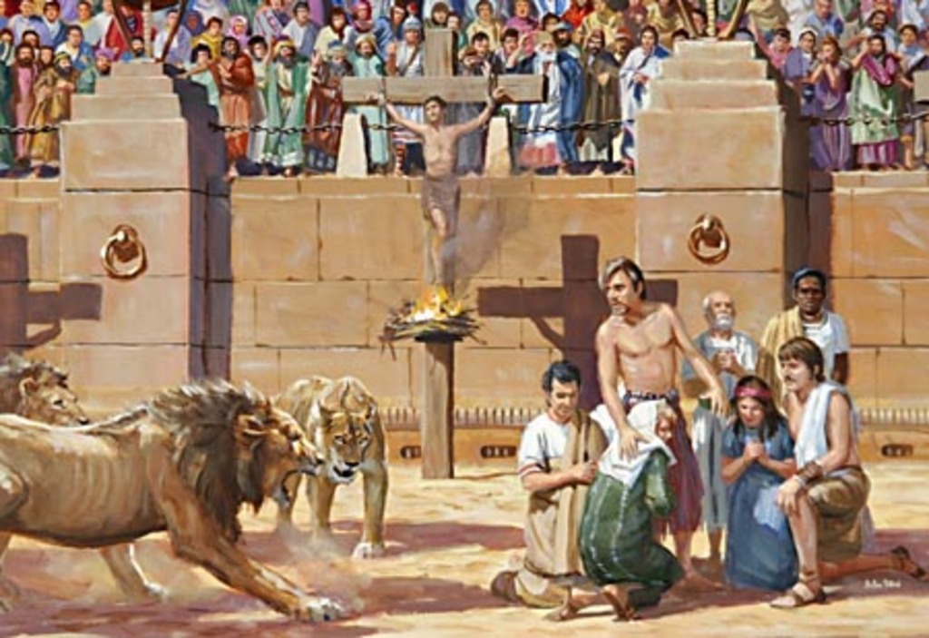
Christianity arises
Spreads quickly along Roman roads
Persecution of Christians
Many were executed

Slide 9
Essential Question
What were the characteristics of the “Pax Romana”?

