Slide 1
Rivers and the Bronze Age
Global History and Geography I
Mr. Cox

Slide 2
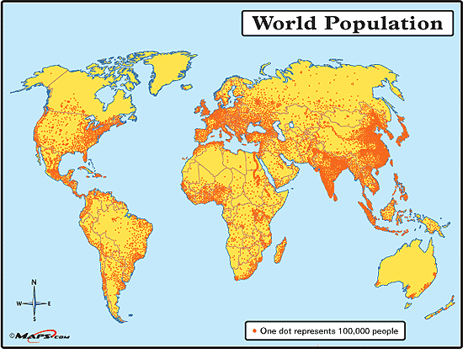
Bellringer
Based on the map below, where do most of the people in the world live? (Near what?)
Essential Question
How did Rivers and the Bronze Age contribute to the spread of culture (cultural diffusion)?

Slide 3
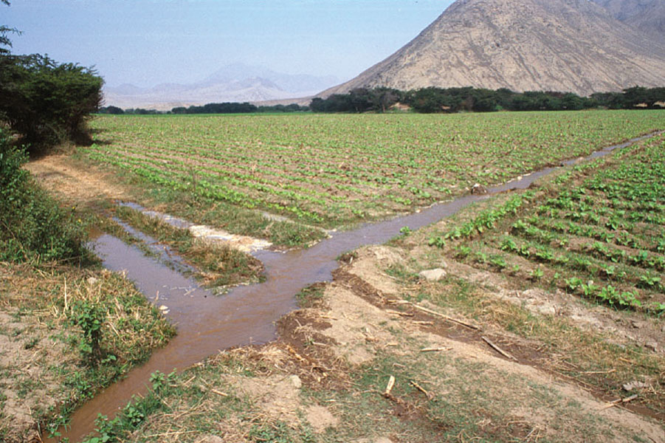
I. The Importance of Rivers
Why settle near rivers? Defense, transportation, agriculture.
Farming required irrigation
People began to travel and interact as a result of the Rivers
Ancient Rivers
Tigris
Euphrates
Nile
Yellow
Indus
Ganges
Yangtze

Slide 4
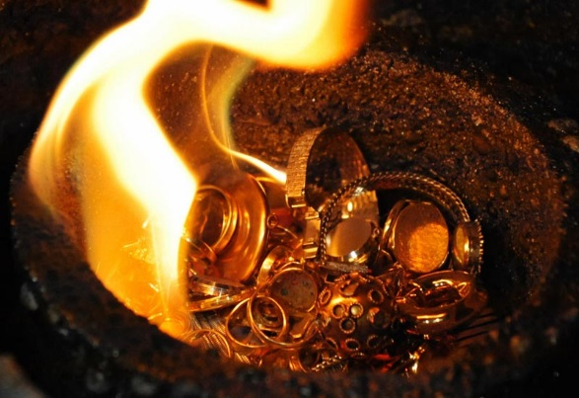
II. The Bronze Age
3,000 B.C.
People learned how to smelt metal
Wheel, plow, and sailboat were all developed
Bronze weapons and armor, provided a military advantage.

Slide 5
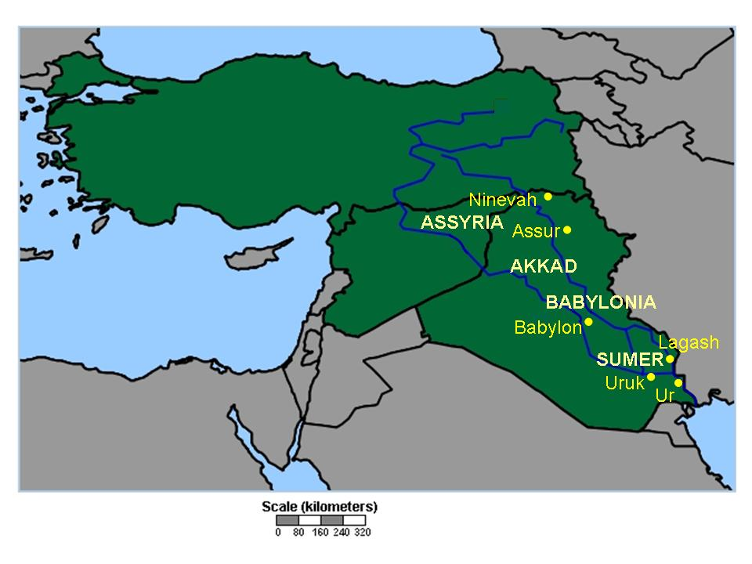
III. Civilization Spreads
Rulers of ancient cities began to crave more land
Led to the rise of city-states, or a political unit that included a city and its surrounding villages and farms
Empires, or a group of city-states controlled by one ruler, emerged
One city-state took control of another through conquest.

Slide 6
Cultural Diffusion
The exchange of ideas, customs, and goods among cultures.
How?
Warfare, Trading, Traveling, Colonization
Cultures blend, or absorb characteristics of other cultures

Slide 7
Cultural Diffusion
The exchange of ideas, customs, and goods among cultures.
How?
Warfare, Trading, Traveling, Colonization
Cultures blend, or absorb characteristics of other cultures
What might be some examples of this?

