Slide 1
Kingdoms of Africa
Global History and Geography I
Mr. Cox

Slide 2
Bellringer
Review: Explain the importance of the Nile to the rise of civilization in Egypt.
Essential Question
How were the west African kingdoms able to develop and maintain their power?

Slide 3
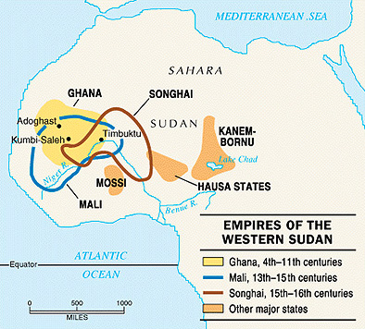
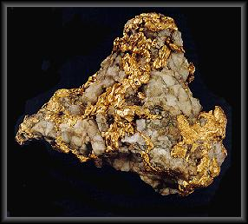
Trading Kingdoms of Africa
Three large and powerful kingdoms emerged in western Africa (Sahara Desert)
Power came from extensive trade networks
Outposts: military stations, defended trade
Gold, salt, ivory were the main goods traded
Commodities: an especially valuable product
Gold and ivory were symbols of wealth, salt prevented dehydration

Slide 4
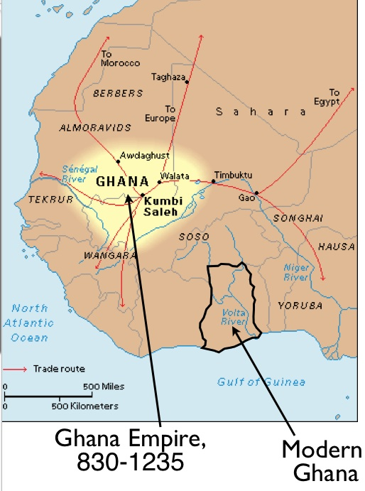
I. Kingdom of Ghana
Located on the “V” of Senegal and Niger Rivers
Capital at Kumbi Saleh, a huge trading city which was actually made up of two towns
Royal Palace
Merchant Homes
King was considered to be divine

Slide 5
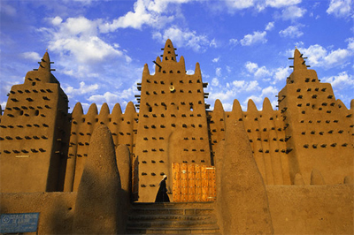
Heavily relied on the trade of gold
Influenced by the spread of Islam, and absorbed much of its culture
Military technology
Politics, currency, architecture, etc
Eventually fell to another powerful African empire

Slide 6
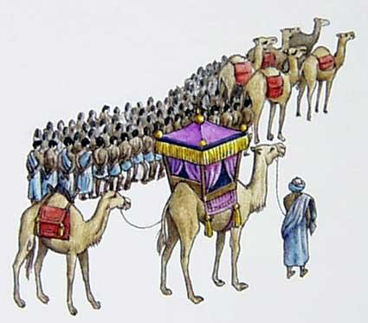
II. The Kingdom of Mali
Powerful gold-trading kingdom ruled by mansas, or kings
City of Timbuktu became a huge trading hub and promoted learning

Slide 7
II. The Kingdom of Mali
Mansa Musa: most famous of all Mali Kings
25 year reign
Expanded the borders of the kingdom
Converted to Islam, and based his ruling on the Quran
Made the hajj, or pilgrimage, to Mecca, making important economic and political connections

Slide 8
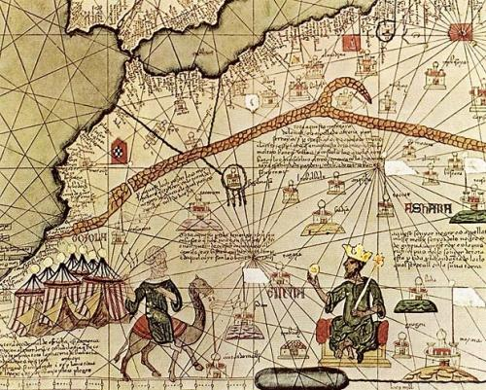

Slide 9
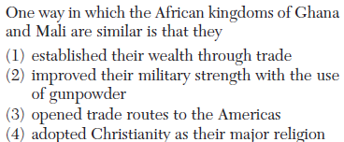

Slide 10
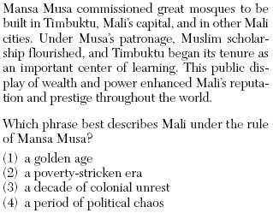

Slide 11
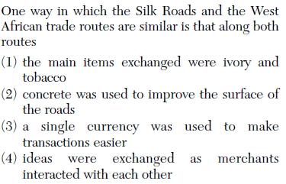

Slide 12
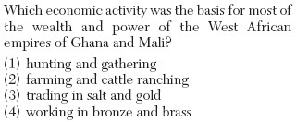

Slide 13
III. The Songhai Empire
Internal issues weakened Mali, gave rise to the city of Gao and the Songhai Empire in 1450 - 1586 CE
Encompassed territory of Ghana and Mali
Two great rulers
Sonni Ali: consolidated territory, followed traditional beliefs
Askia Muhammad: formed governmental departments and adopted Islam
Fell to North African kingdoms

Slide 14
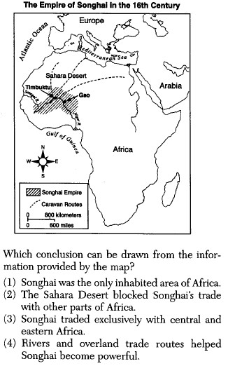

Slide 15
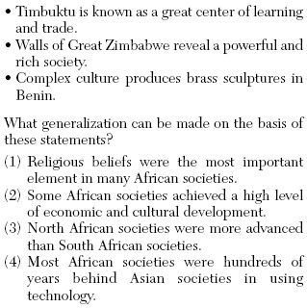

Slide 16
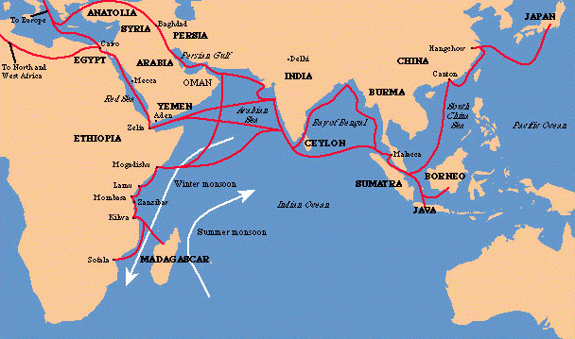
East Africa
http://www.youtube.com/watch?v=jvnU0v6hcUo
Trading states developed
Largely served to connect western empires with other trade networks
Ethiopia: developed as a Christian outpost, had ties to the Vatican and the Holy Land

Slide 17
Essential Question
How were the west African kingdoms able to develop and maintain their power?
Homework

