Slide 1
Colonization of North America
Global History and Geography I
Mr. Cox

Slide 2
Bellringer
Why do Americans celebrate Thanksgiving?
What territories did the English, French, and Spanish colonize in North America?
Essential Question

Slide 3
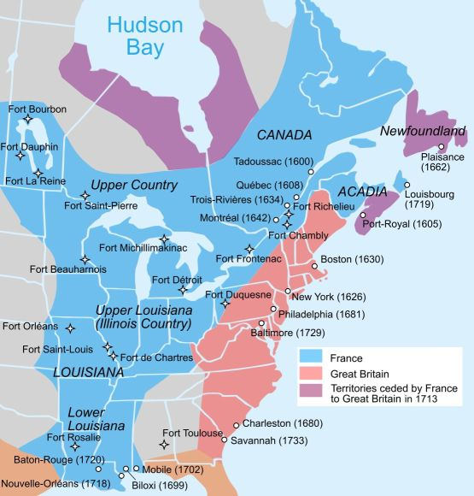
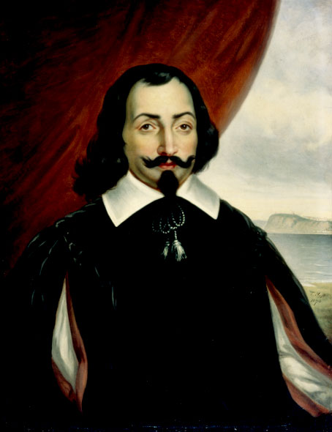
I. New France
Eastern coast of Canada (Newfoundland)
First settled by French fishers and fur trappers in the early 1500’s
First permanent settlement was Quebec by Samuel de Champlain
Using aid from Natives and water routes, New France spread to the Great Lakes and down the Mississippi River to the port of New Orleans

Slide 4
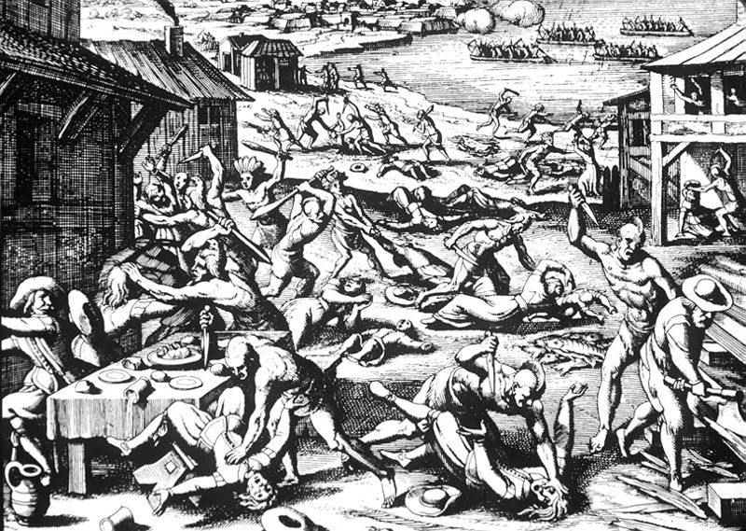
II. English Colonies
England established Jamestown, Virginia colony (1607)
Very little organized government
Horrific conditions, 4/5 died of disease, cold weather, attacks by Natives or starvation
Began to thrive later due to the tobacco crop
Pilgrims, Thanksgiving, Religious Freedom at the Plymouth Colony all happened too..

Slide 5
Over the next 150 years the English established 12 other colonies south of New France
Conquered many Dutch settlements
Focused on agriculture
Plantation
Slave labor from Africa
Governed loosely by officials from England
Massive trade routes were set up between the colonies, Africa, and Europe

Slide 6
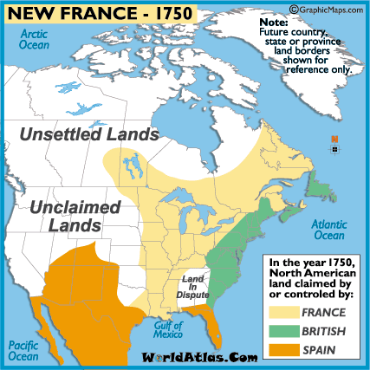
III. Spanish Claims in NA
Included the peninsula of Florida
New Spain spread north from Mexico and into Western US.
Spanish power did begin to fade from the 1500 and 1600s into the 1700s
Massive inflation due to silver mining

Slide 7
IV. Global Competition
England and France emerged as bitter rivals in NA
Grew wealthy as Spain declined
Fought battles in both Europe and the New World
French and Indian War
Fought over land and trade rights
Many natives were involved
Assimilate or fight
https://www.youtube.com/watch?v=rjhIzemLdos

Slide 8
Essential Question
What territories did the English, French, and Spanish colonize in North America?
Homework

